Slide 1

Fine Tuning MySQL For Your Business Needs
An Introduction to MySQL Performance Optimization
Webinar du 13 Mars 2025
Emmanuel COLUSSI
MySQL Solution Architect EMEA
Oracle MySQL GBU

Slide 2


Next Webinar: Leveraging MySQL Enterprise in Public Sector
https://go.oracle.com/MySQLFrenchWebinars

Slide 3

Speaker
Presentation Title
Emmanuel COLUSSI
MySQL Solution Architect EMEA

Slide 4

Agenda
👉 Benchmarking
👉 Profiling / Monitoring Performance
👉 Optimizations :
👉 Schema & Data Types,Indexes,Queries
👉 Advanced MySQL Features
👉 Partitioning, Stored Code, Query Optimizer
👉 MySQL Configuration File
👉 MySQL Server Hardware Configuration

Slide 5
Benchmarking

Slide 6


Why Benchmark?
If You Don’t Measure It, You Can’t Fix It
✅ Capacity Planning
✅ Identify bottlenecks
✅ Reproduce unwanted behaviors
✅ Measure and learn about application behavior
✅ Check how the systems react to different hardware,
software, and configurations
✅ Validate the system can tolerate change
✅ Determine whether the current hardware is sufficient

Slide 7

Benchmarking
Strategies for Benchmarking
Full-Stack
Learn how the whole application behaves, not just MySQL
Find the true bottleneck
Single-Component
Don’t care about the whole application stack
Reproduce and Observe the behavior of a specific issue
Check the impact of a schema or configuration change

Slide 8
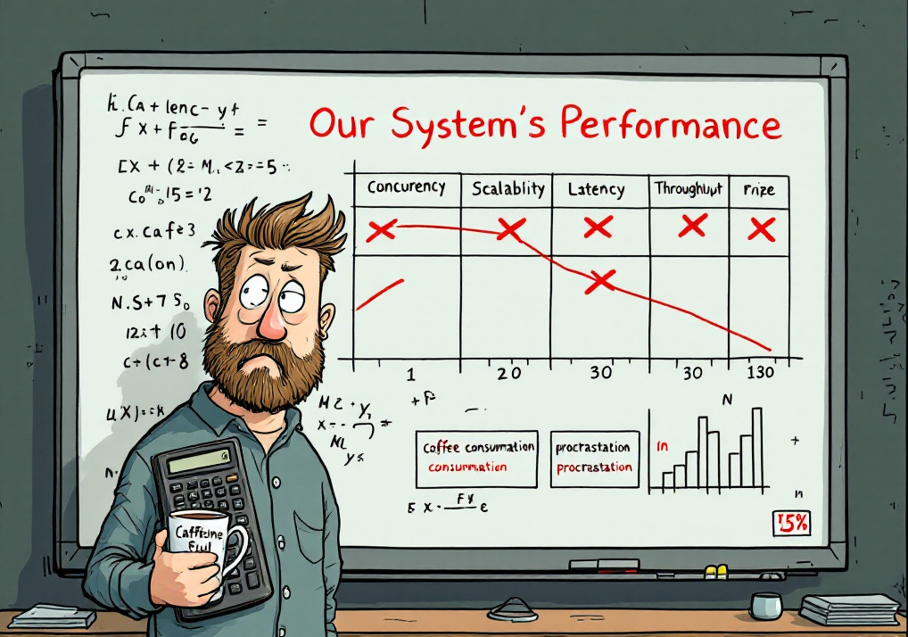
Benchmarking
Measure…
Determine what you want to measure based off your goals
✅ Concurrency (Connections Working Simultaneously)
✅ Growth/Scalability
✅ Latency (Time to Complete a Task)
✅ Throughput (Transactions per Second/Minute)
✅ Whatever is Important to you!

Slide 9

Benchmarking
How Long Should I Benchmark ?
?
?

Slide 10

Benchmarking
Common Tools for Benchmarking
Full-Stack
Apache Jmeter - a load testing tool for analyzing and measuring the performance of a variety of services, with a focus on web applications (https://jmeter.apache.org)
http_load – a tool to that runs multiple http fetches in parallel, to test the throughput of a web server (https://acme.com/software/http_load/)
LoadForge – a cloud focused tool large numbers of simulated users to load test your website, store, API, or application (https://loadforge.com/)
Single-Component (MySQL)
mysqlslap – a load emulation client designed to emulate client load for a MySQL server and to report the timing of each stage. (https://dev.mysql.com/doc/refman/8.0/en/mysqlslap.html)
sysbench – a multi-threaded benchmark often used for database benchmarks (https://dev.mysql.com/downloads/benchmarks.html)
DBT2 - an open-source tool that mimics an OLTP application for a company (https://dev.mysql.com/downloads/benchmarks.html)

Slide 11
Profiling / Monitoring Performance

Slide 12

Profiling / Monitoring Performance
Understand the Metrics Collected
Metrics collected don’t tell you what queries to care about
Look for outliers
Dig into the details
Validate measurement start/end times
Isolate – only change 1 item at a time
DDL, DML = Query
Optimize through profiling

Slide 13
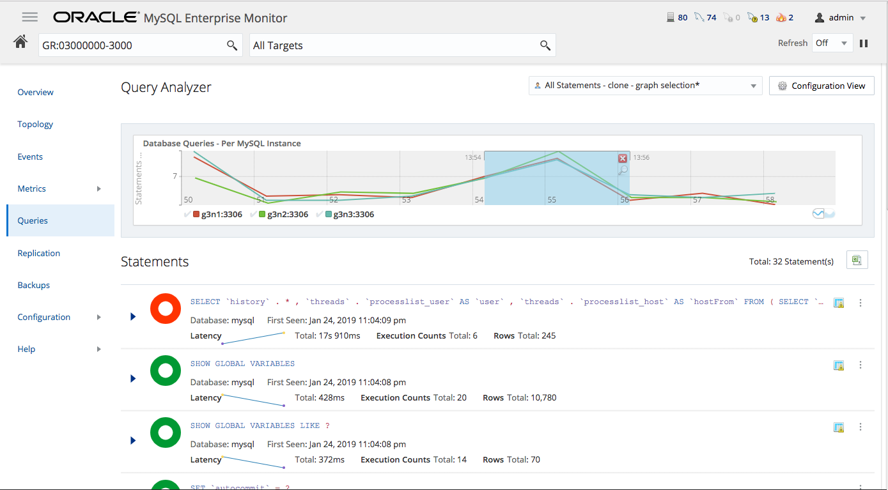
Profiling / Monitoring Performance
MySQL Enterprise Monitor
✅ Modern Look and Feel
✅ Replication Dashboard
✅ Backup Dashboard
✅ Real-time MySQL Performance Monitoring
and Alerts
✅ Visually Manage All Your MySQL Servers
✅ Find and Fix Expensive Queries

Slide 14



Profiling / Monitoring Performance
Oracle Enterprise Manager for MySQL
Database Management
Fleet monitoring, management and data movement across entire IT estate
Ops Automation
Enhanced automation and modernization of key management tasks
Extensibility
Open standards-based extensions for interoperability with 3rd party ecosystems

Slide 15
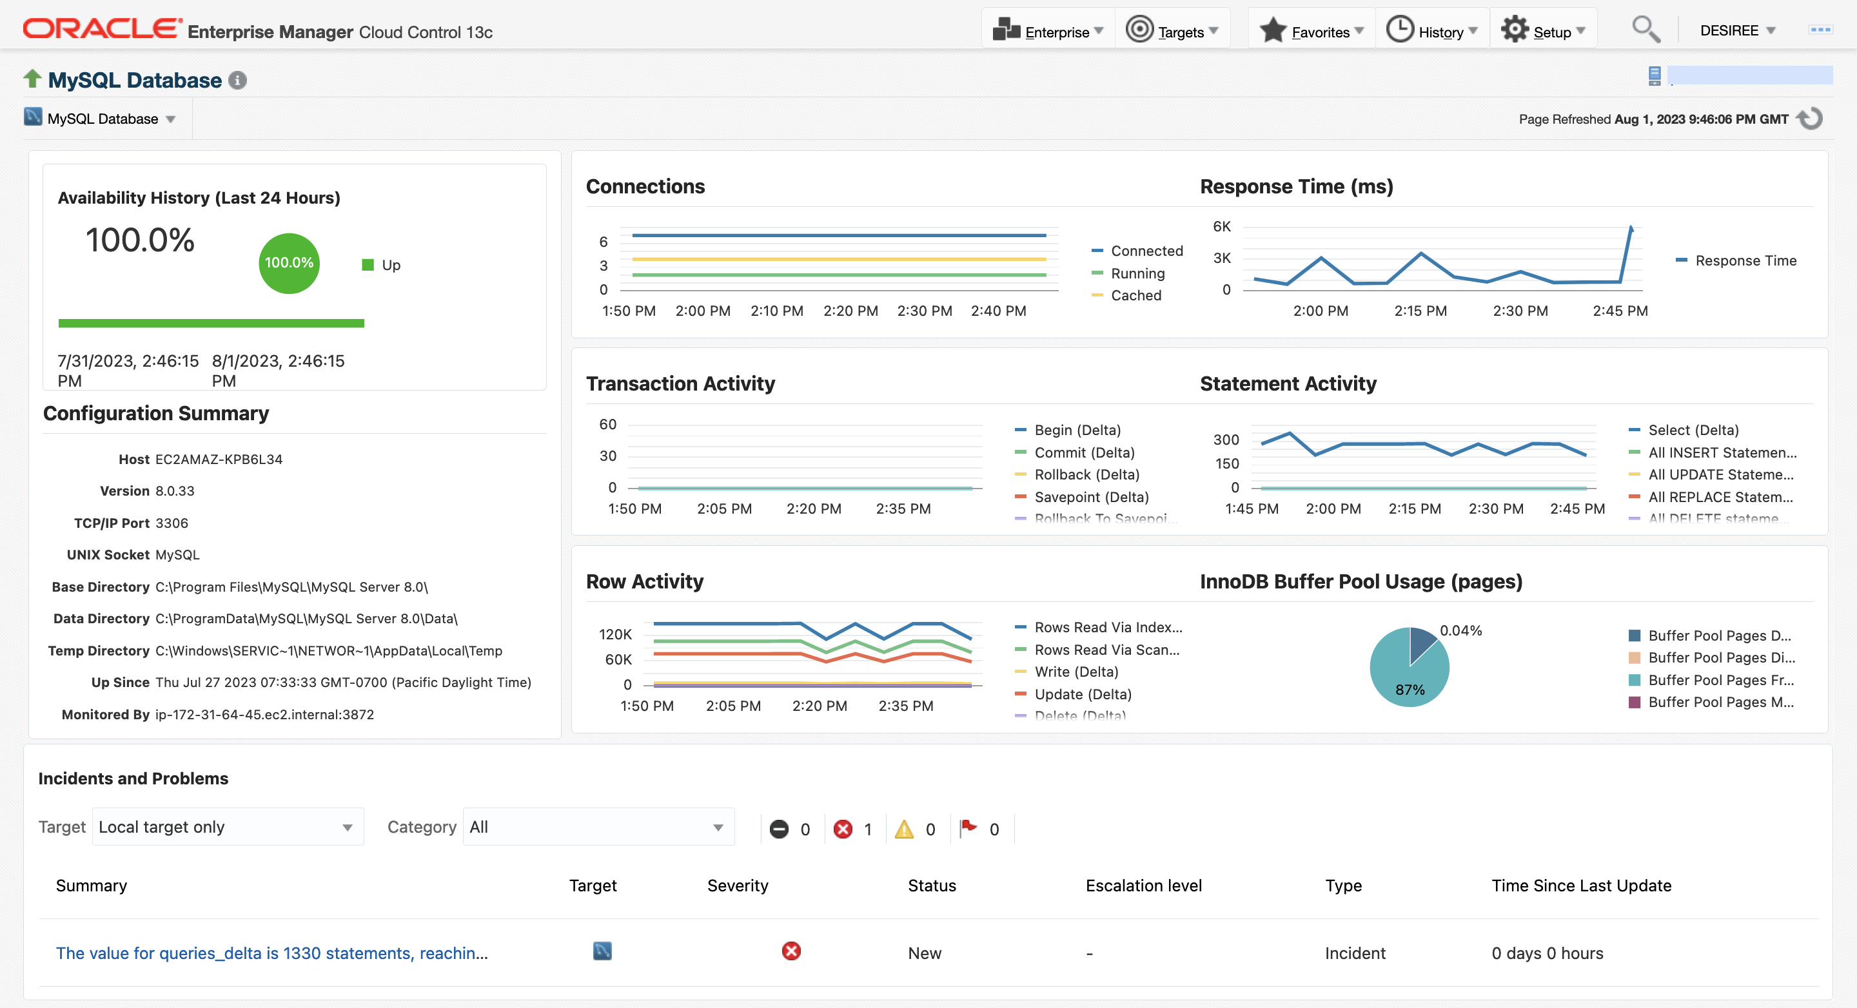
Profiling / Monitoring Performance
EM for MySQL: Get quick insight into health and performance
Availability History
Configuration Summary
Key performance metrics
Track critical incidents

Slide 16
Profiling / Monitoring Performance
EM for MySQL: Comprehensive Monitoring and Compliance Management
Monitoring
Status, response, and performance monitoring
Identify slow running queries using Query Analyzer
Set up monitoring
Extend monitoring using Metric Extensions
Automate alert resolution with Corrective Actions
Standardize monitoring settings across all MySQL databases with Monitoring Templates
Manage MySQL alerts
Create incidents for actionable events
Utilize Event Compression Policies during incident creation to reduce incident volume
Incident notifications (email, SNMP traps, Webhooks, Slack, etc.)
Integration with event and ticketing systems (Microsoft SCOM, PagerDuty, ServiceNow, etc.)
Compliance Management
Use out-of-box standards to evaluate compliance against configuration and security best practices
Compliance dashboard to monitor compliance scores and violations across the fleet of MySQL Databases
Evaluation report to view list of compliance violations and recommended remediations

Slide 17
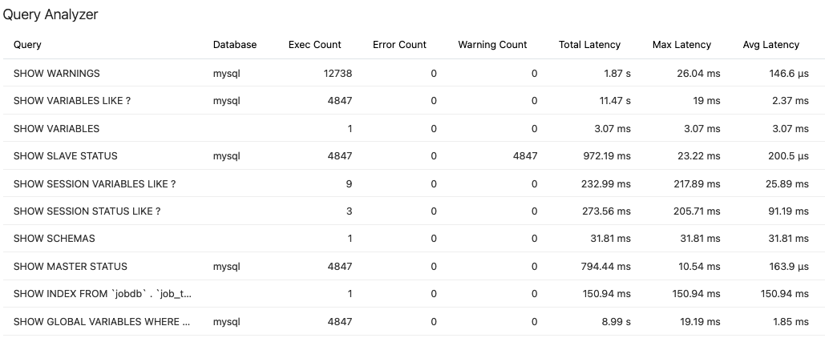
Profiling / Monitoring Performance
EM for MySQL: Monitor slow-running queries using Query Analyzer
Point-in-time snapshot of top 100 queries and statements on the monitored database
Monitor slow running queries that impact application performance
See details of query such as number of executions, number of full table scans, and average latency

Slide 18
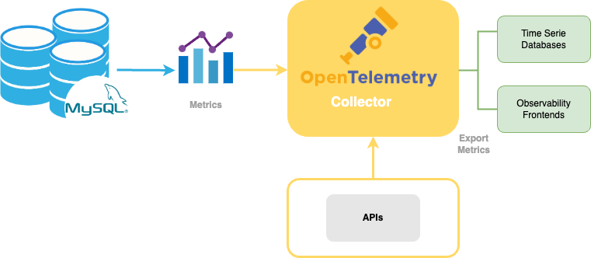
Profiling / Monitoring Performance
Telemetry
Correlates telemetry data across technology stacks ,automates problem identification and diagnosis .
MySQL and OpenTelemetry
Includes Otel libraries to emit Traces, Metrics, Logs
Traces include Spans (unit of work context)
Metrics – choose from 400+ metrics (meters and gauges)
Logs - in progress for 9.0

Slide 19

Profiling / Monitoring Performance
Profiling Tools: Other MySQL Tools
MySQL Slow Query Log - The slow query log consists of SQL statements that take more than long_query_time seconds to execute and require at least min_examined_row_limit rows to be examined. The slow query log can be used to find queries that take a long time to execute and are therefore candidates for optimization.
mysqldumpslow - a utility that parses MySQL slow query log files and summarizes their contents.
SHOW PROFILE/PROFILES Statements - statements that display profiling information that indicates resource usage for statements executed during the current session. (The SHOW PROFILE and SHOW PROFILES statements are deprecated; expect them to be removed in a future MySQL release.)
Query Profiling Using Performance Schema – like SHOW PROFILE/PROFILES, but for all queries running against the server.
EXPLAIN

Slide 20
Profiling / Monitoring Performance
Profiling Tools: mysqldumpslow
Reading mysql slow query log from /usr/local/mysql/data/mysqld-slow.log
Count: 1 Time=4.32s (4s) Lock=0.00s (0s) Rows=0.0 (0), root[root]@localhost
insert into t2 select * from t1
Count: 3 Time=2.53s (7s) Lock=0.00s (0s) Rows=0.0 (0), root[root]@localhost
insert into t2 select * from t1 limit N
Count: 3 Time=2.13s (6s) Lock=0.00s (0s) Rows=0.0 (0), root[root]@localhost
insert into t1 select * from t1

Slide 21
Profiling / Monitoring Performance
Profiling Tools: SHOW PROFILE(S)
mysql> SET profiling = 1;
Query OK, 0 rows affected (0.00 sec) mysql> DROP TABLE IF EXISTS t1;
Query OK, 0 rows affected, 1 warning (0.00 sec)
mysql> SHOW PROFILES;
+----------+----------+--------------------------+
| Query_ID | Duration | Query |
+----------+----------+--------------------------+
| 0 | 0.000088 | SET PROFILING = 1 |
| 1 | 0.000136 | DROP TABLE IF EXISTS t1 |
+----------+----------+--------------------------+ mysql> SHOW PROFILE FOR QUERY 1;
+--------------------+----------+
| Status | Duration |
+--------------------+----------+
| query end | 0.000107 |
| freeing items | 0.000008 |
| logging slow query | 0.000015 |
| cleaning up | 0.000006 |
+--------------------+----------+

Slide 22
Profiling / Monitoring Performance
Profiling Tools: Performance Schema
mysql> SELECT * FROM employees.employees WHERE emp_no = 10001;
…
mysql> SELECT EVENT_ID, TRUNCATE(TIMER_WAIT/1000000000000,6) as Duration, SQL_TEXT
FROM performance_schema.events_statements_history_long WHERE SQL_TEXT like '%10001%';
+----------+----------+--------------------------------------------------------+
| event_id | duration | sql_text |
+----------+----------+--------------------------------------------------------+
| 31 | 0.028310 | SELECT * FROM employees.employees WHERE emp_no = 10001 |
+----------+----------+--------------------------------------------------------+ mysql> SELECT event_name AS Stage, TRUNCATE(TIMER_WAIT/1000000000000,6) AS Duration
FROM performance_schema.events_stages_history_long WHERE NESTING_EVENT_ID=31;
+--------------------------------+----------+
| Stage | Duration |
+--------------------------------+----------+
… REMOVED …
+--------------------------------+----------+

Slide 23
Profiling / Monitoring Performance
Profiling Tools: EXPLAIN/EXPLAIN ANALYZE
mysql> EXPLAIN SELECT t1.a FROM t1\G
*********************** 1. row ***********************
id: 1
select_type: PRIMARY
table: t1
type: index
possible_keys: NULL
key: PRIMARY
key_len: 4
ref: NULL
rows: 4
filtered: 100.00
Extra: Using index 1 rows in set, 1 warning (0.00 sec)
mysql> EXPLAIN ANALYZE SELECT * FROM t1 JOIN t2 ON (t1.c1 = t2.c2)\G
*********************** 1. row ***********************
EXPLAIN: -> Inner hash join (t2.c2 = t1.c1) (cost=4.70 rows=6)
(actual time=0.032..0.035 rows=6 loops=1)
-> Table scan on t2 (cost=0.06 rows=6)
(actual time=0.003..0.005 rows=6 loops=1)
-> Hash
-> Table scan on t1 (cost=0.85 rows=6)
(actual time=0.018..0.022 rows=6 loops=1)

Slide 24
Optimizations
Schema and Data Types

Slide 25
Optimizations
Optimizing at the Database/Table Level
Are the tables structured properly?
Do the columns have the right data types?
Does each table have the appropriate columns for the type of work?
Are you using the appropriate storage engine for each table?
Does each table use an appropriate row format?
Does the application use an appropriate locking strategy?

Slide 26
Optimizations
Choose Optimal Data Types
General ‘Rules of Thumb’
Smaller = Better: Typically, smaller data types are faster because they use less space on disk, memory, CPU cache, etc.
Keep it Simple: Complex data types, strings with mixed collations, etc. require lots of CPU cycles when doing, for example, comparisons. When storing objects using the correct built-in data type. IP address should be stored as integers.
Say ‘No’ to NULL: Nullable columns add extra overhead to optimization. Thus, if you are not going to store NULL values, don’t let a column be null.
UNISGNED: The UNSIGNED attribute disallows negative numbers and doubles the limit of the data type. For example, TINYINT SIGNED’s limit is -128 to 127, whereas TINYINT UNSIGNED is 0 to 255.
CHAR vs VARCHAR: CHAR is the best choice when you know the length of a string. When using VARCHAR, keep the limit close to what you think the biggest string saved will be.
ENUM: Use the ENUM data type in place of a string. For example, if you have a column that stores tracks whether a person has a pet cat or pet dog, use an ENUM (ENUM(‘dog’,’cat’)) instead of a CHAR/VARCHAR.

Slide 27
Optimizations
Pick an Appropriate Row Format
InnoDB tables are created using the DYNAMIC row format by default. To use a row format other than DYNAMIC, configure innodb_default_row_format, or specify the ROW_FORMAT option explicitly in a CREATE TABLE or ALTER TABLE statement. The compact family of row formats, which includes COMPACT, DYNAMIC, and COMPRESSED, decreases row storage space at the cost of increasing CPU use for some operations.
To minimize space even further by storing table data in compressed form, specify ROW_FORMAT=COMPRESSED when creating InnoDB tables, or run the myisampack command on an existing MyISAM table. (InnoDB compressed tables are readable and writable, while MyISAM compressed tables are read-only.)
For MyISAM tables and if you do not have any variable-length columns (VARCHAR, TEXT, or BLOB columns), a fixed-size row format is used. This is faster but may waste some space. You can hint that you want to have fixed length rows even if you have VARCHAR columns with the CREATE TABLE option ROW_FORMAT=FIXED.

Slide 28
Optimizations
Indexing

Slide 29
Optimizations
Indexing
Isolate the column. For example, the following will not use an index: SELECT id, first_name, last_name FROM people WHERE id + 1 = 5;
Selective Index. Not super helpful to index a column with just 2 unique strings in it on a table with 800 million records.
Prefix Index. Prefix the index with a value that gives good selectivity.
Multicolumn Indexes. Be careful how ‘wide’ these get
Primary Keys! Every Table Should Have One!
The primary index of a table should be as short as possible.
MySQL 8.0.31 and later – sql_generate_invisible_primary key
Covering Indexes. Don’t concentrate on the predicate alone, look at the whole query.
Remove duplicate, redundant indexes: INDEX(created_date) = INDEX(created_date, updated_date).
Remove unused indexes.

Slide 30
Optimizations
Queries

Slide 31
Optimizations
Queries – Asking for Too Much
Ask MySQL for the appropriate amount of data
Do you really need to select all data?
If you need a list of authors that published books in the year 2022, don’t use this query… SELECT * FROM demo.authors a INNER JOIN demo.book_authors ba USING(author_id) INNER JOIN demo.books b USING(book_id) WHERE b.pub_year = ‘2022’;
Use this one… SELECT a.* FROM demo.authors a INNER JOIN demo.book_authors ba USING(author_id) INNER JOIN demo.books b USING(book_id) WHERE b.pub_year = ‘2022’;

Slide 32


Optimizations
Queries – Rewriter Query Rewrite Plugin
Bad Query SELECT * FROM authors WHERE author_id + 1 = 5
Add a Rewrite Rule!
INSERT query_rewrite.rewrite_rules (pattern,replacement)
VALUES(
'SELECT * FROM authors WHERE author_id + 1 = ?'
, 'SELECT * FROM authors WHERE author_id = ? - 1’
);

Slide 33
Optimizations
Queries – Chopping It Up
Instead of Running This:
mysql> DELETE FROM books WHERE publication_date < ‘1979-12-11’;
Run This:
rows_affected = 0
do {
rows_affected = do_query (
“DELETE FROM books WHERE publication_date < ‘1979-12-11’ LIMIT 5000”
)
} while rows_affected > 0

Slide 34
Optimizations
Queries – Decompose the Join
Instead of Running This:
SELECT * FROM authors a
JOIN book_authors ba USING(author_id)
JOIN books b USING(book_id)
WHERE a.lastname = ‘Bukowski’;
Run This:
SELECT * FROM authors WHERE lastname = ‘Bukowski’;
SELECT * FROM book_authors WHERE book_id = 12345;
SELECT * FROM books WHERE book_id IN (987,123,4567,9101);

Slide 35
Advanced MySQL Features
Partitioning

Slide 36
Advanced MySQL Features
Partitioning
A partitioned table is a single logical table that’s composed of multiple physical sub tables.
Partitioning can be beneficial to the following scenarios:
When table is too big to fit into memory
Hot rows at the end of a large table
Data can be distributed
Avoid issues caused by system limitations, such as per-inode locking with the ext3 filesystem
Deleting huge chunks of data
Backing up and restoring large data sets

Slide 37
Advanced MySQL Features
Partitioning Types
RANGE - This type of partitioning assigns rows to partitions based on column values falling within a given range.
LIST - Similar to partitioning by RANGE, except that the partition is selected based on columns matching one of a set of discrete values.
COLUMNS - Variants on RANGE and LIST partitioning. Enables the use of multiple columns in partitioning keys.
HASH - With this type, a partition is selected based on the value returned by a user-defined expression that operates on column values in rows to be inserted into the table. The function may consist of any expression valid in MySQL that yields an integer value.
KEY - This type of partitioning is similar to HASH, except that only one or more columns to be evaluated are supplied, and the MySQL server provides its own hashing function. These columns can contain other than integer values, since the hashing function supplied by MySQL guarantees an integer result regardless of the column data type.
Subpartitioning – Known as composite partitioning—is the further division of each partition in a partitioned table.

Slide 38
Advanced MySQL Features
Storing Code in MySQL: Benefits
Share and reuse code
Easier deployment and maintenance
Stored procedures are cached, which lowers overhead when a statement is executed repeatedly
Can be backed up as part of the server
Division of labor between developers and database administrators
Use less bandwidth
Reduce latency
More security advantages

Slide 39
Advanced MySQL Features
Query Optimizer

Slide 40
Advanced MySQL Features
Query Optimizer
Query Plan Evaluation
Switchable Optimizations
The optimizer_switch system variable enables control over optimizer behavior.
Optimizer Hints
Another way to control the optimizer is by using optimizer hints, which can be specified within individual statements. SELECT /*+ NO_RANGE_OPTIMIZATION(t3 PRIMARY, f2_idx) */ f1 FROM t3 WHERE f1 > 30 AND f1 < 33
Index Hints
Statistics

Slide 41
Advanced MySQL Features
Query Optimizer: Query Plan Evaluation
The optimizer_prune_level variable tells the optimizer to skip certain plans based on estimates of the number of rows accessed for each table.
The optimizer_search_depth variable tells how far into the “future” of each incomplete plan the optimizer should look to evaluate whether it should be expanded further. Smaller values of optimizer_search_depth may result in orders of magnitude smaller query compilation times.
For example, queries with 12, 13, or more tables may easily require hours and even days to compile if optimizer_search_depth is close to the number of tables in the query.
At the same time, if compiled with optimizer_search_depth equal to 3 or 4, the optimizer may compile in less than a minute for the same query. If you are unsure of what a reasonable value is for optimizer_search_depth, this variable can be set to 0 to tell the optimizer to determine the value automatically.

Slide 42
Advanced MySQL Features
Query Optimizer: Switchable Optimizations
The optimizer_switch system variable enables control over optimizer behavior. Its value is a set of flags, each of which has a value of on or off to indicate whether the corresponding optimizer behavior is enabled or disabled.
This variable has global and session values and can be changed at runtime.
The global default can be set at server startup.

Slide 43
Advanced MySQL Features
Query Optimizer: Switchable Optimizations
mysql> SELECT @@optimizer_switch\G
*************************** 1. row ***************************
@@optimizer_switch: index_merge=on,index_merge_union=on,
index_merge_sort_union=on,index_merge_intersection=on,
engine_condition_pushdown=on,index_condition_pushdown=on,
mrr=on,mrr_cost_based=on,block_nested_loop=on,
batched_key_access=off,materialization=on,semijoin=on,
loosescan=on,firstmatch=on,duplicateweedout=on,
subquery_materialization_cost_based=on,
use_index_extensions=on,condition_fanout_filter=on,
derived_merge=on,use_invisible_indexes=off,skip_scan=on,
hash_join=on,subquery_to_derived=off,
prefer_ordering_index=on,hypergraph_optimizer=off,
derived_condition_pushdown=on
1 row in set (0.00 sec)

Slide 44
Advanced MySQL Features
Query Optimizer: Optimizer Hints
Another way to control the optimizer is by using optimizer hints.
Can be specified within individual statements.
Applied on a per-statement basis, they provide finer control over statement execution plans than can be achieved using optimizer_switch.
SELECT /*+ NO_RANGE_OPTIMIZATION(t3 PRIMARY, f2_idx) */ f1
FROM t3
WHERE f1 > 30 AND f1 < 33;

Slide 45
Advanced MySQL Features
Query Optimizer: Index Hints
Index hints give the optimizer information about how to choose indexes during query processing.
Not the same as optimizer hints.
Index and optimizer hints may be used separately or together.
# Examples
SELECT * FROM table1 USE INDEX (col1_index,col2_index) WHERE col1=1 AND col2=2 AND col3=3;
SELECT * FROM table1 IGNORE INDEX (col3_index) WHERE col1=1 AND col2=2 AND col3=3;

Slide 46
Advanced MySQL Features
Optimizer Cost Model
Used by the optimizer to generate execution plans.
Based on estimates of the cost of various operations that occur during query execution.
The optimizer has a set of compiled-in default “cost constants” available to it to make decisions regarding execution plans.
The optimizer also has a database of cost estimates to use during execution plan construction. These estimates are stored in the server_cost and engine_cost tables in the mysql system database and are configurable at any time. (The intent of these tables is to make it possible to easily adjust the cost estimates that the optimizer uses when it attempts to arrive at query execution plans.)
# Change default value for io_block_read_cost due to slow disk
UPDATE mysql.engine_cost
SET cost_value = 3.0
WHERE cost_name = 'io_block_read_cost';
FLUSH OPTIMIZER_COSTS;

Slide 47
MySQL Configuration File

Slide 48
MySQL Configuration File
There is no one-size-fits-all
Most of the default settings are fine
Consider using innodb_dedicated_server for dedicated InnoDB Servers
Know the difference between global and session variables
Security and performance often don’t go together
Know what your OS and Hardware can do - For Example
Some flash devices support atomic 16 KB writes. This would be an ideal situation for disabling the doublewrite buffer.
However, in addition to disabling the doublewrite buffer you will most likely be required to use O_DIRECT flush method and the XFS filesystem.

Slide 49
MySQL Configuration File
innodb_buffer_pool_size
One of the most important variables to be set when using the InnoDB storage engine
Setting to 75%-80% of available memory works for many workloads
However, the following is a formula to more precisely determine optimal sizing: Total Memory Available - Operating System - Applications Running on the Server, such as Monitoring Agents - The MySQL Server – e.g., Buffers for Query Operations - Memory for the Operating System to cache all or part (the tail) of InnoDB Log Files (e.g. Binary Logs) - Any Other Buffers, such as Key Buffer The result of the above should be multiplied by 105% to account for the overhead of InnoDB. Round the result down and that is your innodb_buffer_pool_size.

Slide 50
MySQL Configuration File
innodb_log_file_size
Second most important variable to be set when using the InnoDB storage engine
Innodb_log_file_size dictates the size in bytes of the commit log files stored by MySQL
These log files will protect database data during power loss events or crashes.
To determine size, weigh the overhead of routine data changes against recovery time in the event of a crash
A common way to size: Run the SHOW INNODB STATUS command and observe the “Innodb_os_log_written” variable. Watch an intervals of 10 plus seconds and note the peak value. Example: If the peak is 100 KB per second, a 256 MB log file will hold 2,560 seconds of log. This is typically enough data to hold.

Slide 51
MySQL Configuration File
sort_buffer_size
Buffer for performing sorts in MySQL
Not specific to any storage engine and applies in a general manner for optimization
Increasing can speed up ORDER BYs
MySQL doesn’t allocate any memory for this buffer until a query needs it
When allocated, the entire chunk is allocated
Avoid setting to high! Word of advice is ”Keep it small and only raise it for queries that need it.”

Slide 52
MySQL Configuration File
tmp_table_size / max_heap_table_size
Control how large an in-memory temporary table can grow
If the size needed exceeds this value, the temporary table is converted to an on-disk temporary table
Recommended to set the value to both these variables the same
32MB is a good starting place, but may be too small
Avoid making too large
Queries that need large temporary tables are probably going to be more efficient on disk anyway

Slide 53
MySQL Server Hardware Configuration

Slide 54

MySQL Server Hardware Configuration
Hardware
CPU Count:
Carefully evaluate the number of processors required to support
your workloads.
Storage:
Even with an excellent RAID storage system (1, 5, etc.), do not
neglect the configuration of file systems.
Ensure that disk performance is optimized.
Volume Strategies:
Consider duplicating volumes rather than creating a single large
volume.
Use striping techniques to improve I/O performance.

Slide 55
MySQL Server Hardware Configuration
Common Hardware / Operating System Settings
Linux
Change the IO scheduler (noop or deadline).
Ensure ulimit values are set appropriately.
"numactl --interleave all" to prevent heavy swapping when a single large InnoDB buffer pool is all allocated on one CPU.
Set vm.swappiness=1.
Default IO queue size is 128, higher or lower can be useful.
XFS is typically faster.
Windows
To support more connections or connection rates higher than about 32 per second you may need to set MaxUserPort higher and TcpTimedWaitDelay for TCP/IP, particularly for older Windows Servers.
Hardware
SSD: data, InnoDB undo logs, maybe temporary tables if not using tmpfs or other RAM-based storage for them.
Spinning disks: Binary logs, InnoDB redo logs, bulk data. Also, large SATA drives are cheap and useful for working and archival space as well as the biggest of bulk data sets.
Hyperthreading on is likely to be a good choice in most cases.

Slide 56


MySQL Server Hardware Configuration
MySQL Enterprise Thread Pool
MySQL Enterprise Thread Pool
Improves scalability as concurrent connections grow
Threads are prioritized and statements queued
External Clients
Thread Pool
Connection Execution Threads
Thread Group 1
Threads 1 - 4096
Thread Group 1
Thread Group 2
Threads 4097 - 8193
Thread Group 2
Thread Group N
Threads 8194 - N
Thread Group N
Internal Clients

Slide 57

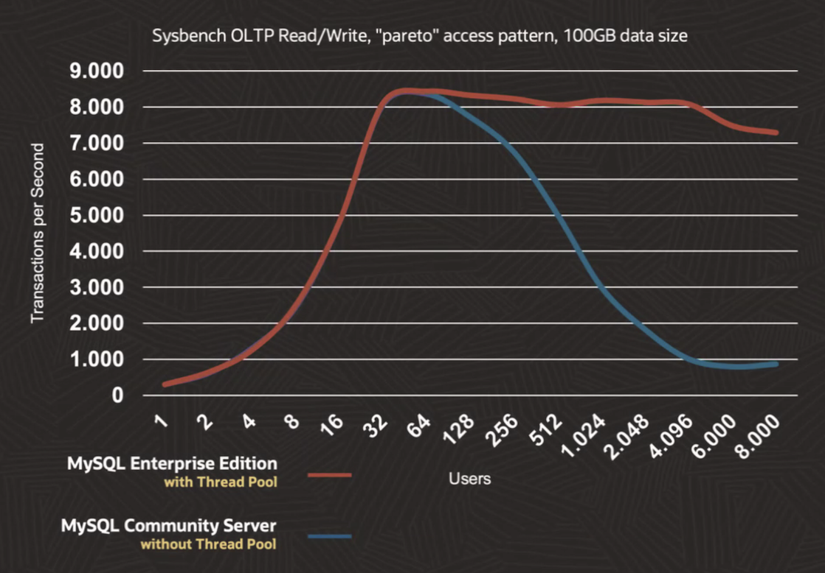
Building Blocks of MySQL Enterprise Edition
Scalability: Enterprise Thread Pool

Slide 58
Resources
MySQL Server
https://dev.mysql.com/doc/refman/9.2/en/mysqld-server.html
Optimization Overview
https://dev.mysql.com/doc/refman/9.2/en/optimize-overview.html
Partitioning
https://dev.mysql.com/doc/mysql-shell/9.2/en/mysql-innodb-cluster.html
Blogs
https://blogs.oracle.com/search.html?q=MySQL
Webinar
https://github.com/colussim/webinar/
Oracle Education
https://www.oracle.com/education/training/mysql/

Slide 59

Thank you
Emmanuel COLUSSI
emmanuel.colussi@oracle.com

